Slide 1
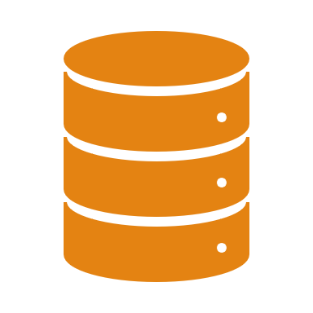
MangoDB Vs MySQL
Atharva dixit (c-38)
Aditya Holkar(C-57)
Upendra kadre(c-69)
Swapnil katti(c-72)

Slide 2
What is DBMS ?
What is a Database?
A database is a collection of related data which represents some aspect of the real world.
What is DBMS?
Database Management System (DBMS) is a software for storing and retrieving users' data while considering appropriate security measures.
It consists of a group of programs which manipulate the database.
The DBMS accepts the request for data from an application and instructs the operating system to provide the specific data. In large systems, a DBMS helps users and other third-party software to store and retrieve data.

Slide 3
What is RDBMS ?
RDBMS. Stands for "Relational Database Management System.“.
An RDBMS is a DBMS designed specifically for relational databases. Therefore, RDBMSes are a subset of DBMSes.
A relational database refers to a database that stores data in a structured format, using rows and columns.
This makes it easy to locate and access specific values within the database. It is "relational" because the values within each table are related to each other. Tables may also be related to other tables.
Each row in a table has its own unique key. Rows in a table can be linked to rows in other tables by adding a column for the unique key of the linked row

Slide 4
Providers
MySQL
MariaDB
PostegreSQL
Cassandra
SqLite
Microsoft SQL
Oracle

Slide 5
MySQL introduction
MySQL is the world’s most popular open source database. With its proven performance, reliability, and ease-of-use, MySQL has become the leading database choice for web-based applications
MySQL is released under an open-source license. So you have nothing to pay to use it.
MySQL is a very powerful program in its own right. It handles a large subset of the functionality of the most expensive and powerful database packages.
MySQL uses a standard form of the well-known SQL data language.
MySQL works on many operating systems and with many languages including PHP, PERL, C, C++, JAVA, etc.
MySQL works very quickly and works well even with large data sets.
MySQL is very friendly to PHP, the most appreciated language for web development.
MySQL supports large databases, up to 50 million rows or more in a table. The default file size limit for a table is 4GB, but you can increase this (if your operating system can handle it) to a theoretical limit of 8 million terabytes (TB).
MySQL is customizable. The open-source GPL license allows programmers to modify the MySQL software to fit their own specific environments
.

Slide 6
Importance
Data Security
On-Demand Scalability
High Performance
Round-the-clock Uptime
Comprehensive Transactional Support
Reduced Total Cost of Ownership
Open source

Slide 7
Typical Methods
Data Definition Language (DDL) refers to the CREATE, ALTER and DROP statements. DDL or Data Definition Language actually consists of the SQL commands that can be used to define the database schema".
Data Manipulation Language (DML) refers to the INSERT, UPDATE and DELETE statements .DML allows to add / modify / delete data itself.
Data Query Language (DQL) refers to the SELECT, SHOW and HELP statements (queries). SELECT is the main DQL instruction. It retrieves data you need. SHOW retrieves infos about the metadata. HELP... is for people who need help.
Data Control Language (DCL) refers to the GRANT and REVOKE statements. DCL is used to grant / revoke permissions on databases and their contents. DCL is simple, but MySQL's permissions are rather complex. DCL is about security.
Data Transaction Language (DTL) refers to the START TRANSACTION, SAVEPOINT, COMMIT and ROLLBACK [TO SAVEPOINT] statements .DTL is used to manage transactions (operations which include more instructions none of which can be executed if one of them fails).

Slide 8
What is NoSQL
A NoSQL (originally referring to "non SQL" or "non relational")[1] database provides a mechanism for storage and retrieval of data that is modeled in means other than the tabular relations used in relational databases.
A NoSQL database includes simplicity of design, simpler horizontal scaling to clusters of machines and finer control over availability
The data structures used by NoSQL databases are different from those used by default in relational databases which makes some operations faster in NoSQL.

Slide 9
PROVIDERS
MongoDB falls in the category of NoSQL document based database.
Key value store: Memcached, Redis, Coherence
Tabular: Hbase, Big Table, Accumulo
Document based: MongoDB, CouchDB, Cloudant

Slide 10
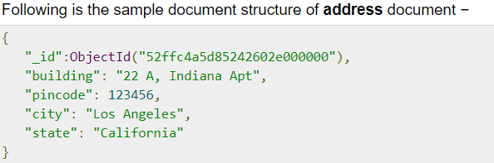
Importance
Large volumes of structured, semi-structured, and unstructured data
Agile sprints, quick iteration, and frequent code pushes can be easily manged with MangoDB
Object-oriented programming is used that is easy to use and flexible
Efficient, scale-out architecture instead of expensive, monolithic architecture.
High scalability –
High availability –

Slide 11
Typical methods usage
use DATABASE_NAME
db.dropDatabase()
db.createCollection(name, options)
Db.COLLECTION_NAME.insert(document)
db.COLLECTION_NAME.find()

Slide 12
My sql vs mangodb
MySQl | MangoDB
In MySQL, each individual records are stored as ‘rows’ in a table. | In MongoDB, each individual records are stored as ’Documents’.
A ‘table’ is used to store rows (records) of similar type. | Documents belonging to a particular class or group as stored in a COLLECTION.
MySQL as the name suggests uses STRUCTURED QUERY LANGUAGE for database access. | MongoDB is what is called a NOSQL DATABASE. This means that pre-defined structure for the incoming data can be defined
The schema can not be changed | if required different documents in a collection can have different structures
MySQL concept does not allow efficient replication and sharding but in MySQL one can access associated data using joins which minimizes duplication. | MySQL concept does not allow efficient replication and sharding but in MySQL one can access associated data using joins which minimizes duplication.

Slide 13
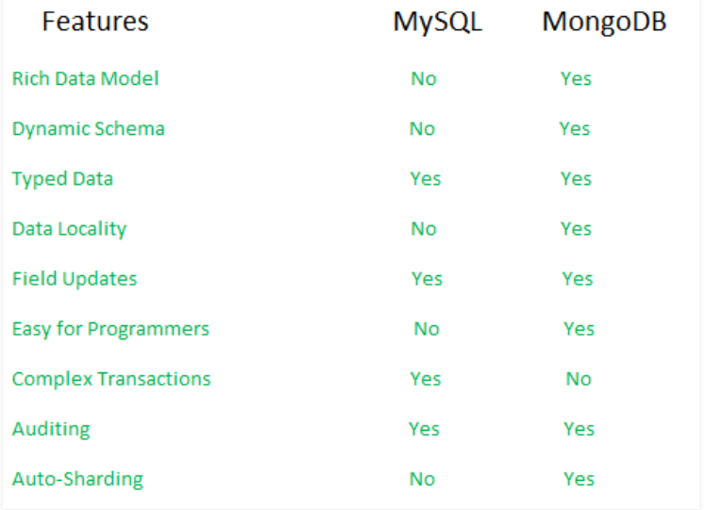
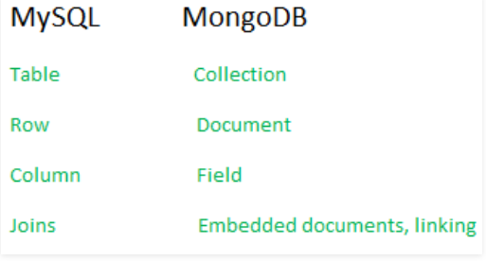
MySQL vs MangoDB
Differences in Terminologies
Key-Feature comparison

Slide 14

Thank You!

